Slide 1

Thesis Investments Committee and Screening for Stocks

Slide 2
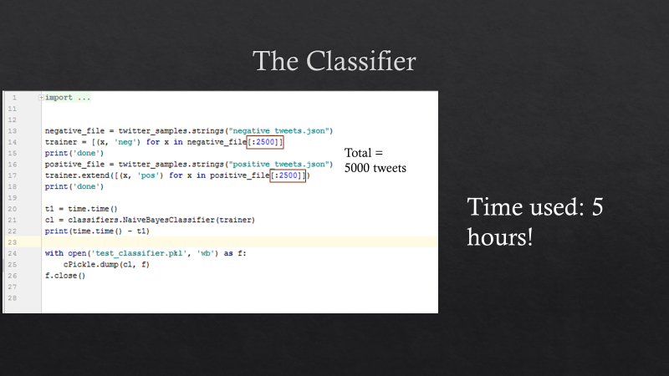
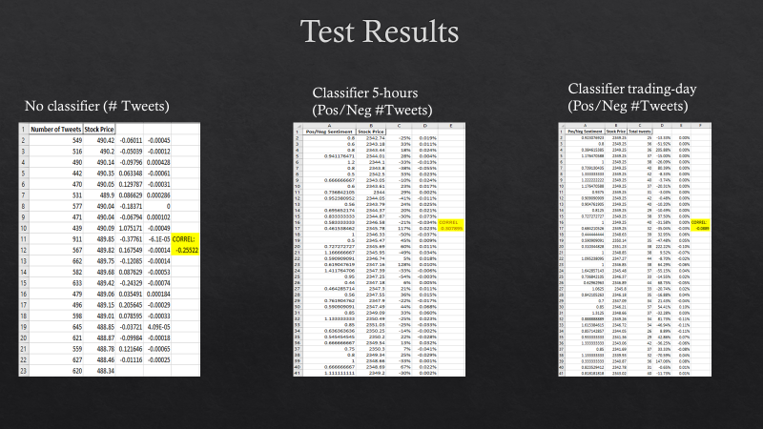
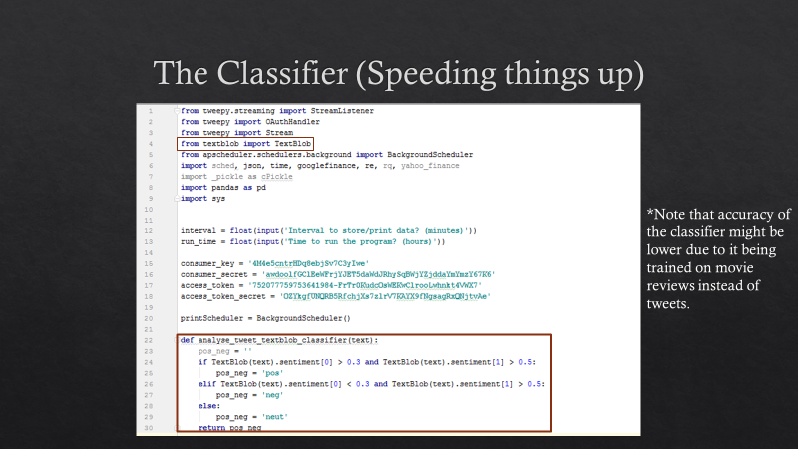
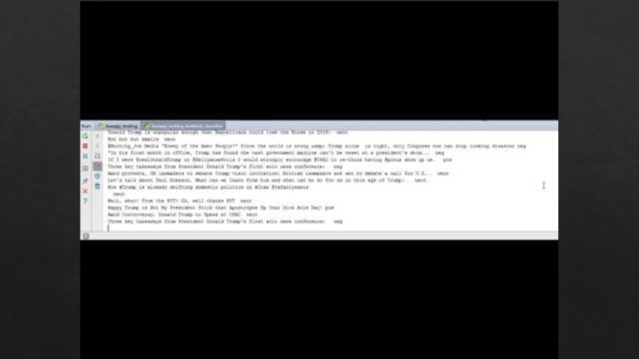
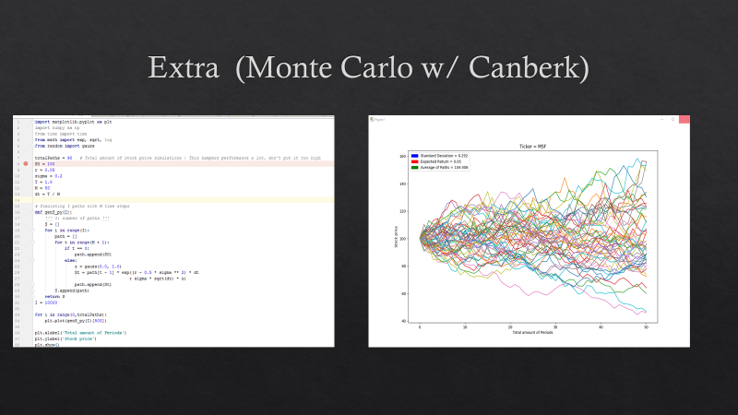
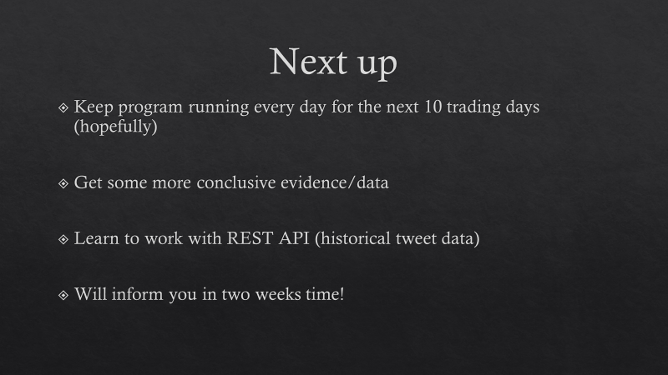
Last Meeting

Slide 3
This Meeting
Application Monte Carlo Simulation
Lots of Twitter data analyzed!
Stock pitch using screening method IBS Capital Allies
Programming along the way

Slide 4
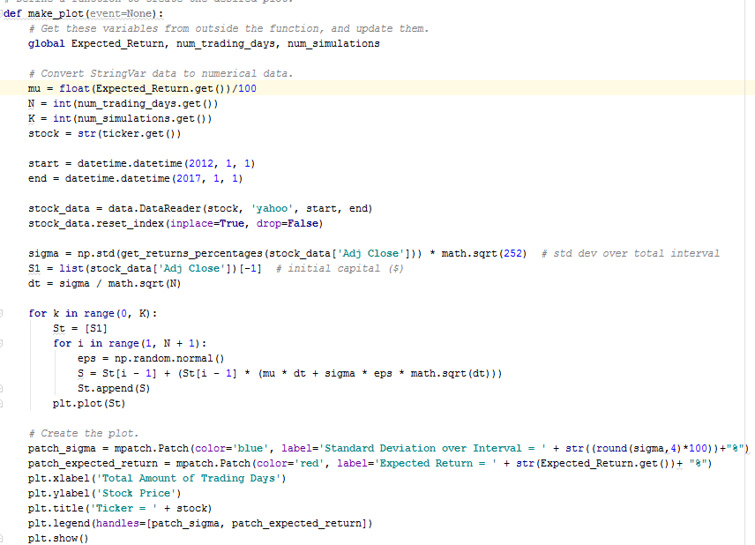
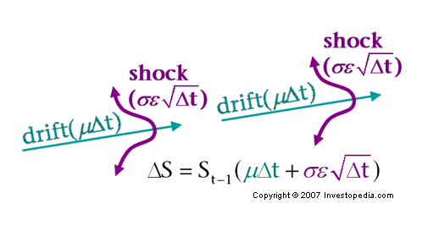
Monte Carlo Simulation
1
2
3

Slide 5
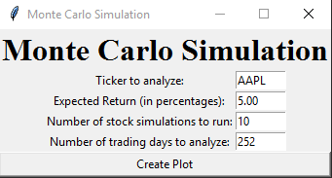
Result (w/ pyinstaller)

Slide 6
Magellan Midstream Partners
https://www.magellanlp.com/uploadedFiles/Investors/Financials/2012/Ex%2099%20-%20MMP%2012.31.12-8-K%20FINAL%20DRAFT.pdf
https://www.quantopian.com/research/notebooks/Untitled.ipynb
https://finance.yahoo.com/quote/MMP?p=MMP
https://www.quantopian.com/help/fundamentals#asset-classification

